Slide 1
Ordinary Least SQUARES REGRESSION
-eric page
-Pradeep Bhat
-Neeraj Ankam
-Srujan bandarkar

Slide 2
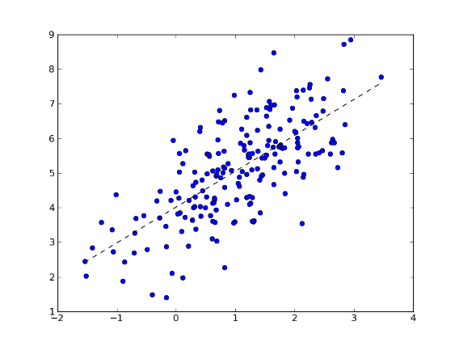
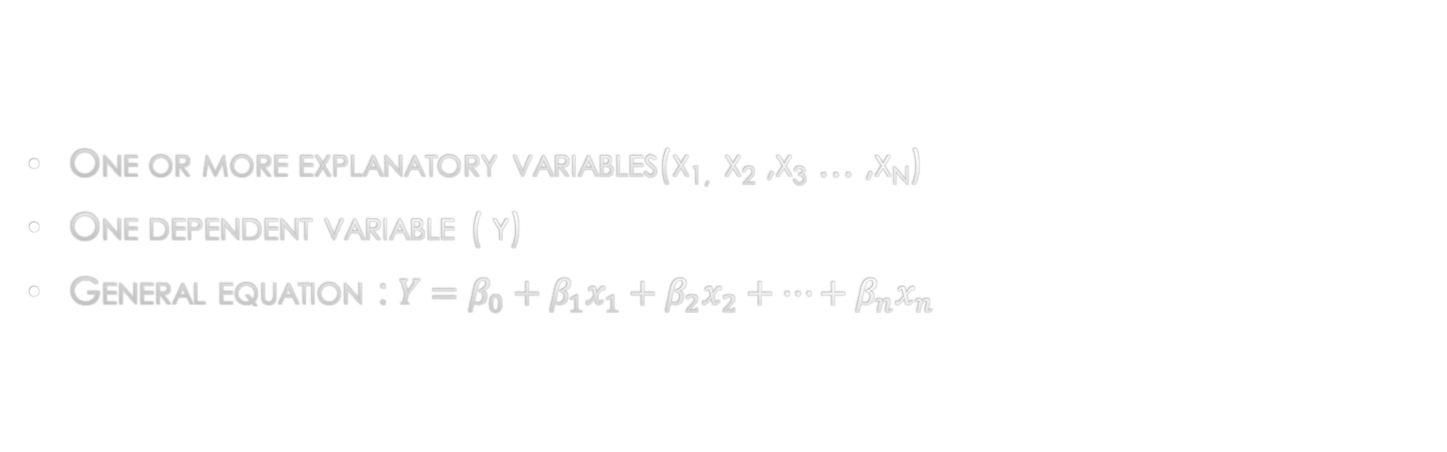
Linear regression
One or more explanatory variables(x_{1,} x₂ ,x₃ … ,x_{n})
One dependent variable ( y)
General equation : $Y=β_{0}+β_{1}x_{1}+β_{2}x_{2}+…+β_{n}x_{n}$

Slide 3
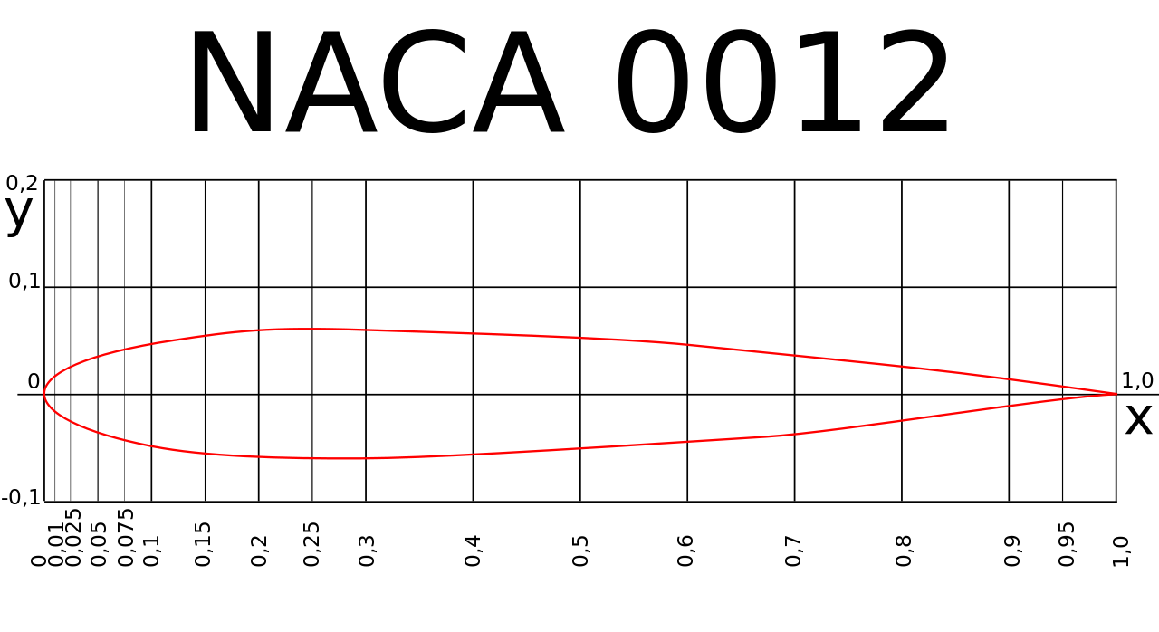
OUR DATASET
NAME: AIR FOIL SELF-NOISE DATASET
5 i/p variables and 1 o/p variable
Description:
Given a set of inputs like the angle of attack, chord length et cetera, we need to predict the scaled sound pressure level(decibels).
Why?
Because sound is an efficiency and environmental factor

Slide 4
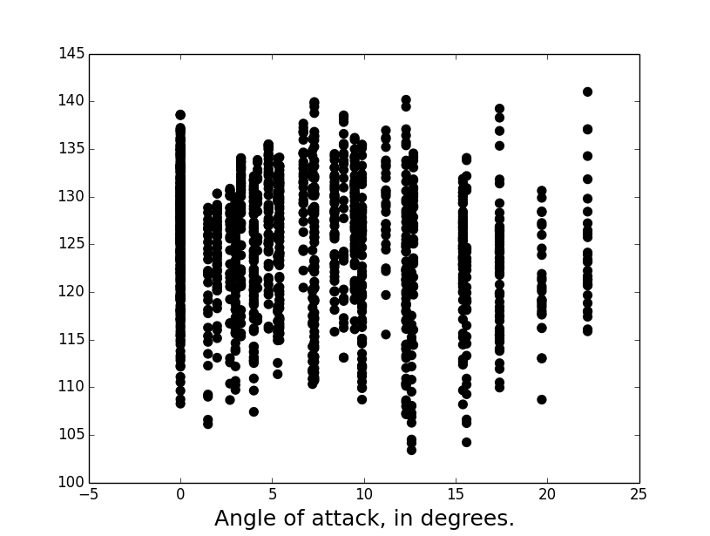
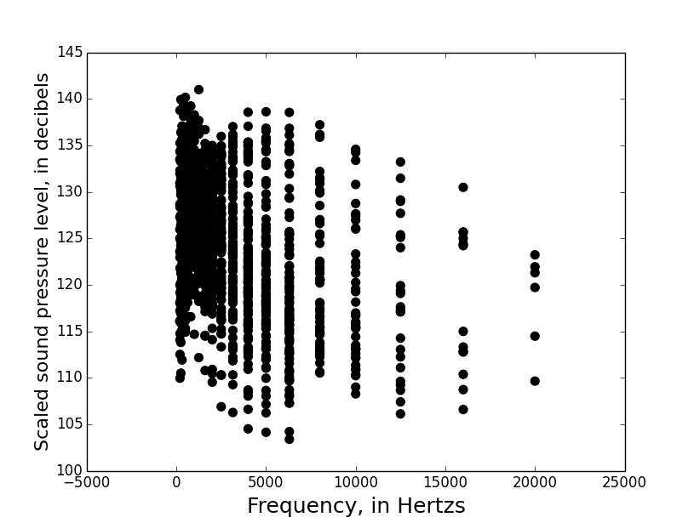
Output variable variation W.R.T input variables

Slide 5
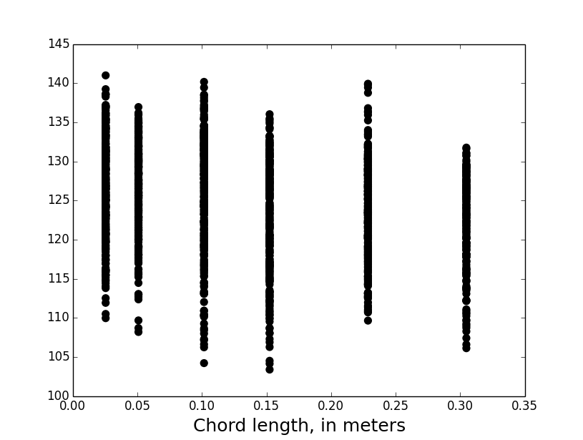
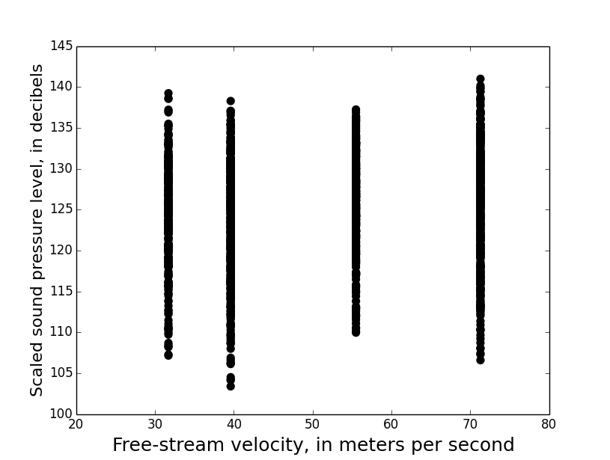

Slide 6
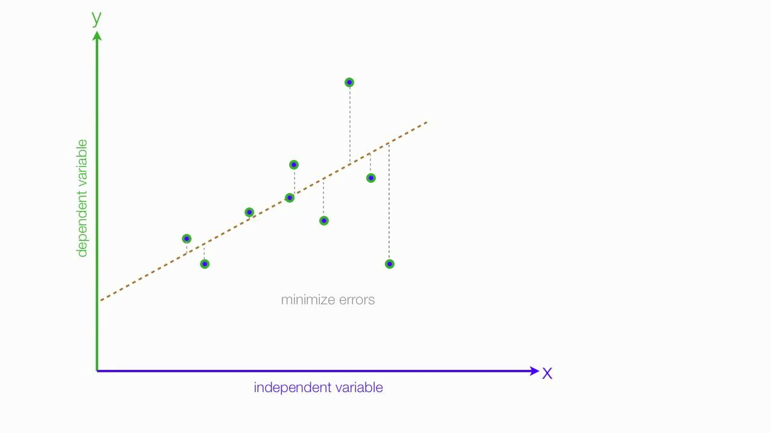
ORDINARY LEAST SQUARES
Most commonly used linear regression technique.
Goal: minimize the sum of squared distances
between the actual values of explanatory value(y)
and predicted values(X’s)

Slide 7
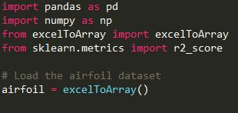

OUR APPROACH
Import dataset(excel file) as a numpy array in python
Separate the data into input and output values.

Slide 8


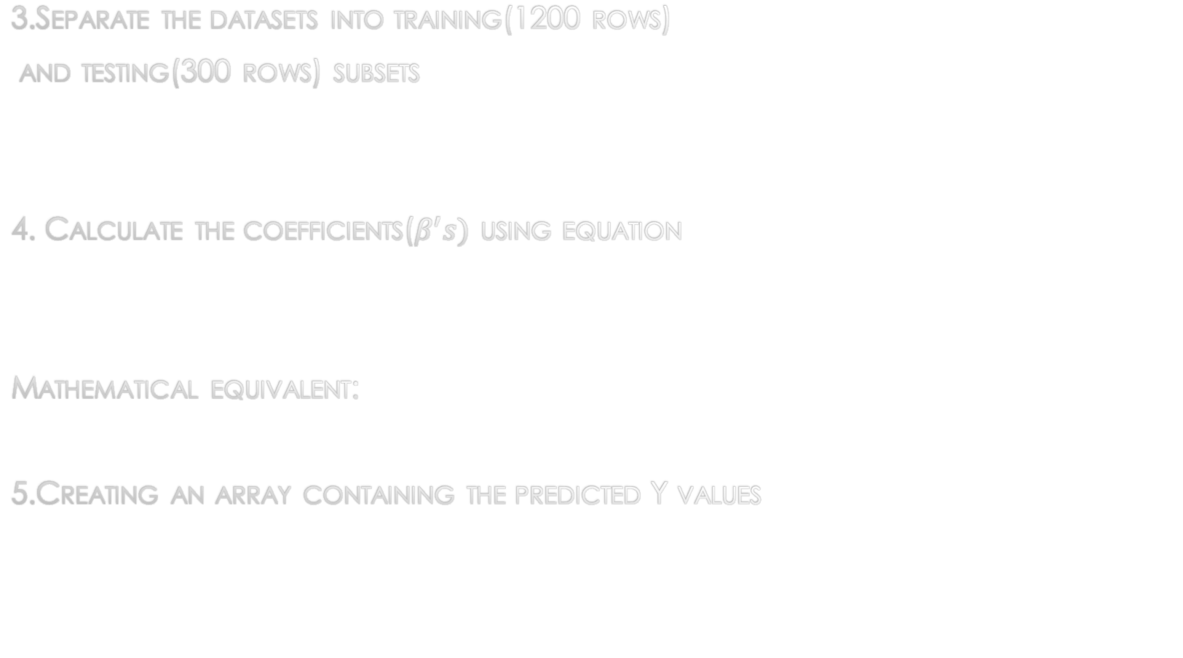

3.Separate the datasets into training(1200 rows)
and testing(300 rows) subsets
4. Calculate the coefficients($β^{′}s)$ using equation
Mathematical equivalent:
5.Creating an array containing the predicted Y values
$${\left[x^{T}x\right]}^{−1}⋅x^{T}⋅y$$

Slide 9
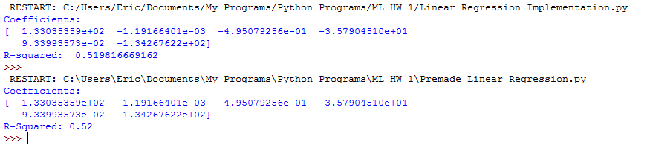
6. Calculating the R-squared value for comparison purposes.

Slide 10

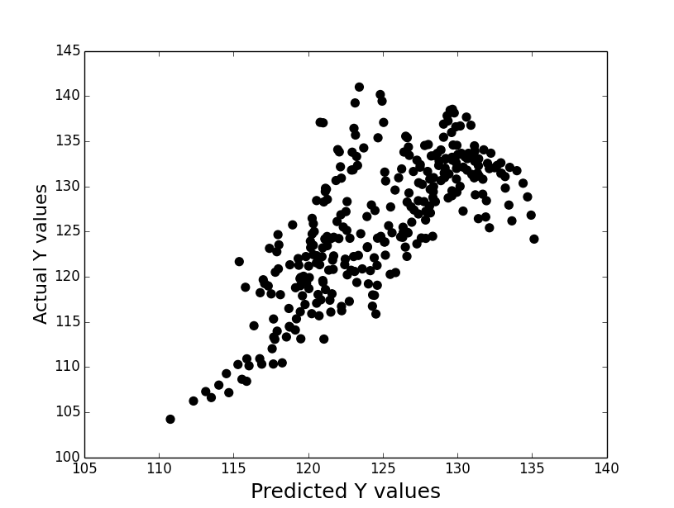
PREDICTED VS ACTUAL VALUES OF OUTPUT VARIABLE

